Slide 1

UE20CS390A – Capstone Project Phase – 1
Project Progress Review #3
Project Title : Deploying eox microservices using cloud
platform service and improving scalability
Project ID : PW_23_VP_01
Project Guide : Prof Venkatesh Prasad, Mr.Vijay R(EOX
Vantage)
Project Team : Veena Garag PES1UG20CS492
Adarsh Kumar PES2UG20CS016
Suchit S Kallapur PES1UG20CS438
Yuvaraj D C PES1UG20CS521

Slide 2
Deploy EOX microservices using cloud platform service and improving scalability.
Abstract and Scope
Our project mainly deals with dockerizing eox microservices and deploying it into kubernetes cluster.
A well thought process been done to understand and develop architecture that will result in better performance in terms of scalability, resource utilization, reduced downtime and latency etc
This research and implementation is used to reduce the life-cycle of deployment of the finished containers into cloud
Easier to deploy and maintain

Slide 3
Deploy EOX microservices using cloud platform service and improving scalability.
Suggestions from Review - 2
Architectural diagrams
Implementation details
Project plan

Slide 4
Deploy EOX microservices using cloud platform service and improving scalability.
Design Approach
Containerize the microservices that are provided by EOX Vantage.
Define the Kubernetes deployment and service, and configure the Kubernetes ingress to map traffic to different backends based on rules defined via K8 API.
Deploying the microservices through Istio Service Mesh Architecture on top of Kubernetes, which we suggest will have Inherent properties of Kubernetes like autoscaling, self healing, service discovery and load balancing, and communication advantages from service mesh architecture. Monitor and Test which provides better results.
Deploying to a localhost through different methods of deployments such as rolling, blue-green and canary deployment.

Slide 5
Deploy EOX microservices using cloud platform service and improving scalability.
Design Constraints :
Resource limitations of the Kubernetes cluster, such as available CPU, memory, and storage.
Network connectivity between microservices and with external services, including load balancers and ingress controllers.
Security considerations, such as access control, authentication, and encryption.
Monitoring and logging requirements to ensure service availability and troubleshoot issues. Used during testing phase.
Platform compatibility: Kubernetes may have compatibility constraints with certain operating systems, programming languages, or other technologies that can limit the choice of tools and technologies used for deploying microservices.

Slide 6
Deploy EOX microservices using cloud platform service and improving scalability.
Assumptions:
The microservices are designed to be stateless and scalable, with multiple replicas running in parallel to handle traffic.
Containerization: Microservices deployed on Kubernetes are typically containerized, so it is assumed that each microservice can be packaged as a container image that can be deployed on the platform.
Service Discovery: Service discovery is an important assumption when deploying microservices on Kubernetes. It is assumed that each microservice can be discovered by other services in the cluster, allowing them to communicate with each other.
The microservices are independent and loosely coupled, with minimal dependencies on other microservices or infrastructure components.

Slide 7
Deploy EOX microservices using cloud platform service and improving scalability.
Dependencies
Kubernetes resources such as pods, deployments, services, and ingress controllers, are used to manage the lifecycle and networking of microservices.
Container images are stored in a container registry, such as Docker Hub or Google Container Registry and pulled by Kubernetes nodes when needed.
Service discovery and load balancing are provided by Kubernetes services, which can route traffic to the appropriate microservice instance.
Persistent storage for microservices, such as databases or file systems, are provisioned using Kubernetes Persistent Volumes and Claims. Thus it is important to ensure that storage is properly configured and accessible by the microservices.
A well configured network to enable communication between microservice.

Slide 8
Deploy EOX microservices using cloud platform service and improving scalability.
Proposed Methodology / Approach
Methodology for microservice deployment on Kubernetes
To address the challenges of microservice deployment on Kubernetes, we propose a methodology that includes the following steps: design, build, test, deploy, and monitor.
During the design phase, the microservices are identified and their dependencies are mapped out. In the build phase, the services are developed and containerized. Testing ensures that each service works correctly and communicates with other services. Deployment involves setting up the Kubernetes cluster and deploying the services. Finally, monitoring ensures that the services are running correctly and alerts are raised if any issues arise.

Slide 9
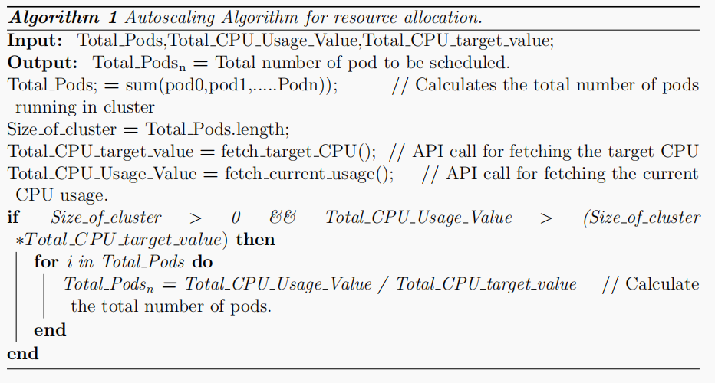
Deploy EOX microservices using cloud platform service and improving scalability.
Proposed Methodology / Approach
The methodology for load balancing and scalability
Custom Controller Algorithm
Deshpande, Neha (2021) Autoscaling Cloud-Native Applications using Custom Controller of Kubernetes.
https://norma.ncirl.ie/5089/
Masters thesis, Dublin, National College of Ireland.

Slide 10
Deploy EOX microservices using cloud platform service and improving scalability.
Proposed Methodology / Approach
METHODOLOGY:The setup contains one master node and two worker nodes,In this research an attempt is made to write a custom controller to schedule the required number of pods to overcome resource wastage and website crashes. There is a component called Kube-controllermanager.YAML in the Kubernetes cluster. To control replicas, the parameters in the YAML file are transferred to the Kube-API server, and then to the Kube-controller manager. Next, the Kube-API server informs the custom controller to start or create new pods.
CONCLUSION:
By using a custom controller which makes the autoscaling decisions and schedules the pods, this research attempts to solve the issue of inefficient pod allocation to applications.

Slide 11
Deploy EOX microservices using cloud platform service and improving scalability.
Proposed Methodology / Approach
Benefits and Drawbacks of the proposed methodology
Reduce cost for maintaining Quality of Service(QoS)
Supports only CPU intensive microservices

Slide 12
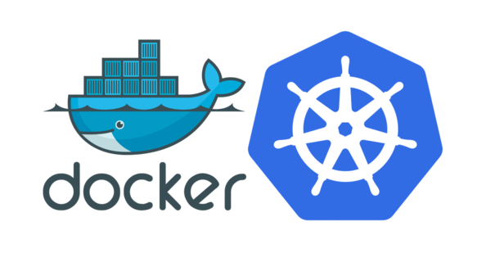
Deployment architecture of microservices in kubernetes cluster
Deploy EOX microservices using cloud platform service and improving scalability.

Slide 13
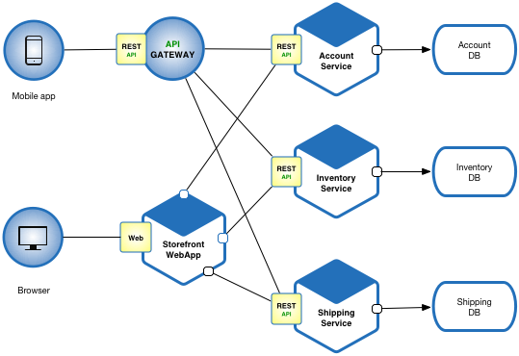
What are microservices
Deploy EOX microservices using cloud platform service and improving scalability.
Introduction
Microservices are a software architecture style that consists of small, independent and loosely coupled services.
Each service is focused on a specific business function and communicates with other services through well-defined interfaces. Microservices enable faster development, testing, deployment and scaling of complex applications.

Slide 14
Deploy EOX microservices using cloud platform service and improving scalability.
Microservices - also known as the microservice architecture - is an architectural style that structures an application as a collection of services that are:
Independently deployable
Loosely coupled
Organized around business capabilities
Owned by a small team
The microservice architecture enables an organization to deliver large, complex applications rapidly, frequently, reliably and sustainably - a necessity for competing and winning in today’s world.

Slide 15
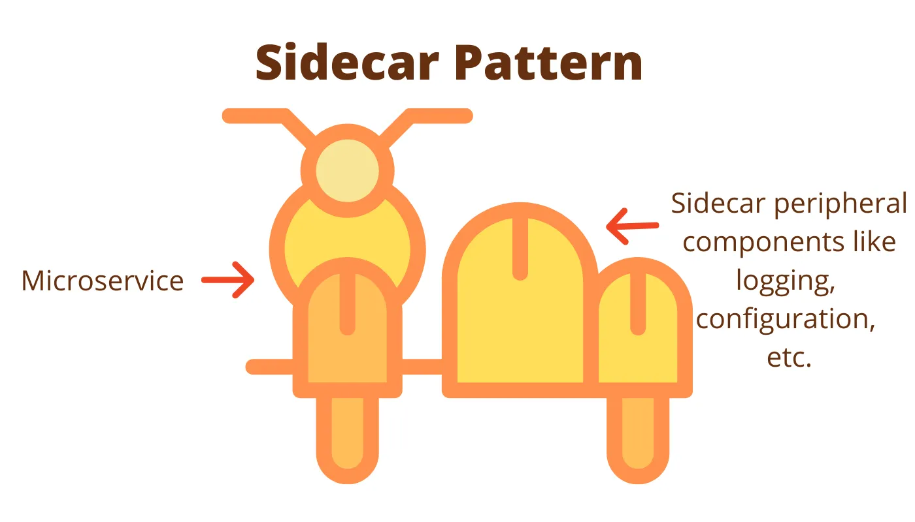
What are the design patterns used to deploy these microservices to kubernetes cluster
Deploy EOX microservices using cloud platform service and improving scalability.
There are various design patterns that can be used but depending on the application the pattern can used
One such design pattern is the sidecar design pattern

Slide 16
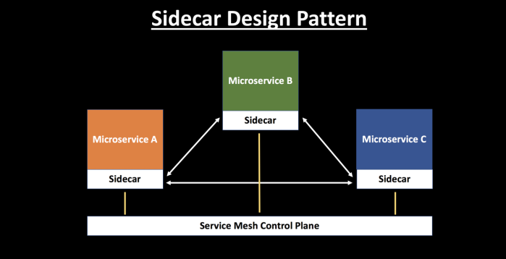
Sidecar design pattern
Deploy EOX microservices using cloud platform service and improving scalability.
Each microservice is associated with a sidecar, which is used to manage traffic flow between the microservices gathers telemetry data, and enforces policies.
The sidecars abstract away complexity from the application and handle functionalities like service discovery, traffic management, load balancing, circuit breaking, etc.

Slide 17
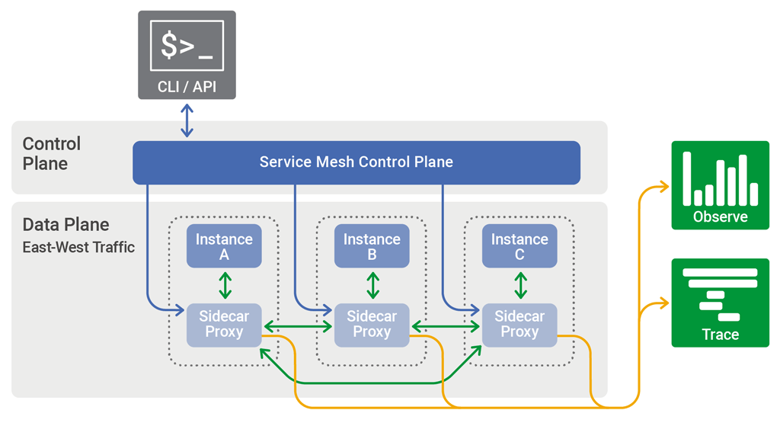
Deploy EOX microservices using cloud platform service and improving scalability.
Service-mesh Architecture

Slide 18
Deploy EOX microservices using cloud platform service and improving scalability.
Key features:
1. Data plane: The data plane is responsible for managing the traffic between the microservices. It is typically composed of a set of lightweight proxy instances, such as Envoy, that are deployed alongside each microservice instance. These proxies handle all of the network traffic between microservices and provide features such as load balancing, routing, and service discovery.
2. Control plane: The control plane is responsible for managing the data plane proxies and providing high-level policies and configuration for the microservices deployment. It typically includes a set of control plane components, such as Istio or Linkerd, that work together to configure and manage the proxies.

Slide 19
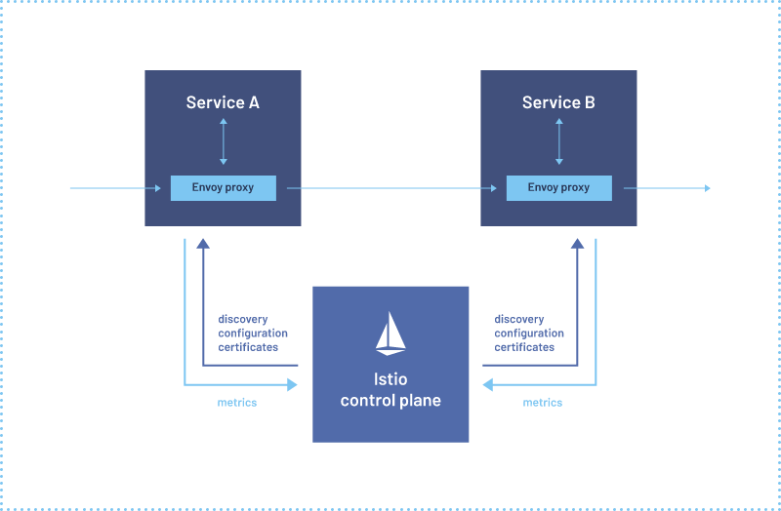
Istio service mesh architecture
Deploy EOX microservices using cloud platform service and improving scalability.

Slide 20
Deploy EOX microservices using cloud platform service and improving scalability.
Istio is an open-source service mesh platform
It helps manage and secure microservices in a Kubernetes cluster
1. Envoy proxy: Istio deploys a sidecar proxy, the Envoy proxy, alongside each service instance in the cluster. The proxy intercepts all inbound and outbound traffic to the service instance and sends it through the Istio data plane.
2. Istio data plane: The Istio data plane consists of a set of Envoy proxies and a control plane. The Envoy proxies forward requests to other services and implement the various Istio features such as traffic management, security, and observability.
3. Istio control plane: The Istio control plane manages the Envoy proxies and their configuration. It provides a central place to configure and manage the various Istio features, such as routing rules, security policies, and telemetry.

Slide 21
Deploy EOX microservices using cloud platform service and improving scalability.
4. Traffic management: Istio can route traffic between services based on various criteria, such as HTTP headers, source IP address, or user identity. It can also implement features like load balancing, circuit breaking, and retries.
5. Security: Istio can enforce mutual TLS authentication between services, implement access control policies, and provide encryption for service-to-service communication.
6. Observability: Istio provides various telemetry features such as request tracing, metrics, and logging. This allows operators to understand how traffic is flowing through the system and to diagnose issues

Slide 22
Using service-mesh architecture on top of kubernetes
Deploy EOX microservices using cloud platform service and improving scalability.
This will result in addon benefits from both the aspects,
Inherent properties of kubernetes like autoscaling, self healing, service discovery and load balancing etc and communication advantages from service mesh architecture
We are basically thinking to implement service mesh architecture of deployment on kubernetes this will allows better communication and scalability and performance.
We can also have an abstraction layer to implement custom control algorithm for autoscaling of pods because in literature we saw that default kubernetes algorithm play bad when lot of requests are directed autoscaling will simply deploy too many nodes and result in wastage of resources.

Slide 23
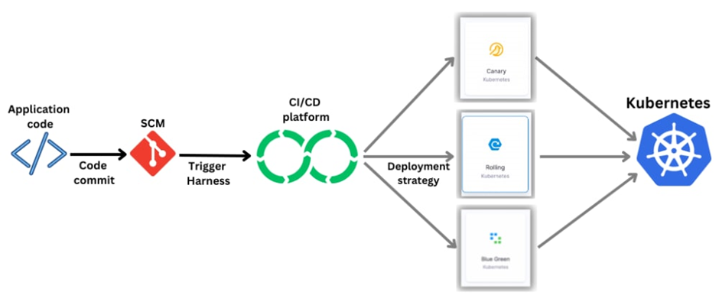
How do we deploy it
Deploy EOX microservices using cloud platform service and improving scalability.
There are various strategies of deployment rolling, bluegreen, canary deployment

Slide 24
Deploy EOX microservices using cloud platform service and improving scalability.
Canary deployment
Kubernetes canary deployment is a technique for rolling out new features or changes to a small subset of users or servers before releasing the update to the entire system. This is done by creating a new replica set with the updated version of the software while keeping the original replica set running. A small percentage of traffic is then routed to the new replica set, while the majority of the traffic continues to be served by the original replica set.
Rolling deployment
Rolling deployment involves creating a new replica set with the updated version of the software while gradually scaling down the old replica set.
Blue-green deployment
The Blue-Green Kubernetes deployment strategy is a technique for releasing new versions of an application to minimise downtime and risk. It involves running two identical environments, one serving as the active production environment (blue) and the other as a new release candidate (green). The new release candidate is thoroughly tested before being switched with the production environment, allowing for a smooth transition without any downtime or errors.

Slide 25
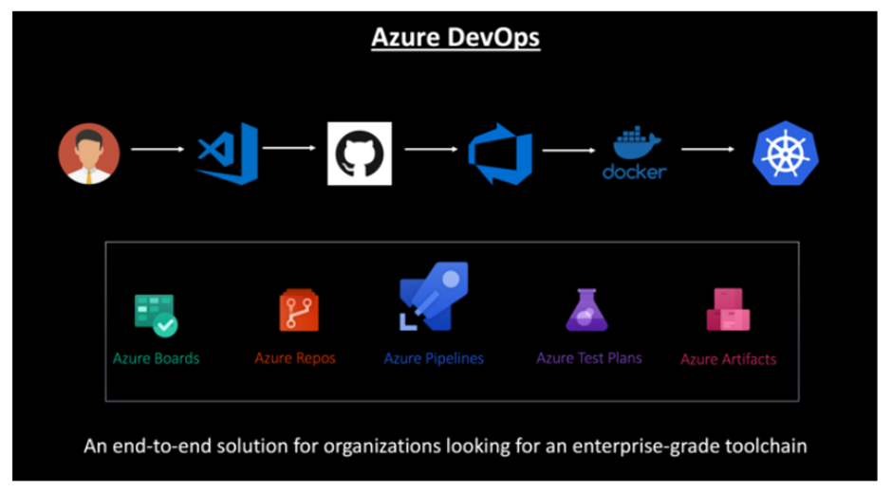
CI/CD Pipeline to Deploy Microservices on Kubernetes
Deploy EOX microservices using cloud platform service and improving scalability.
In a microservice ecosystem, containers make it easy for you to build and deploy services. You can orchestrate the deployments of these containers using Kubernetes in Azure Container Service
•In the below CI/CD Pipeline leveraging Azure DevOps, a developer modifies the code and checks it into GitHub.

Slide 26
Deploy EOX microservices using cloud platform service and improving scalability.
Using Azure DevOps, continuous integration triggers the application build, the container image is built and the unit tests are executed.
•The container image is pushed to Azure Container Registry.
• Continuous deployment triggers the application deployment into Managed Kubernetes — Azure Container Service

Slide 27
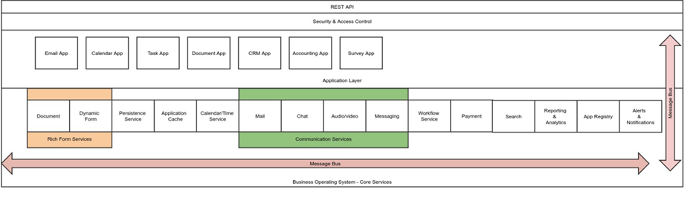
EOX vantage logical architecture of application and services
Deploy EOX microservices using cloud platform service and improving scalability.

Slide 28
Deploy EOX microservices using cloud platform service and improving scalability.
Technologies Used
Docker : Docker is a software platform that enables developers to use containers for their applications. Containers are self-contained environments with all the necessary dependencies and configurations for an application to run. Docker provides tools and services such as Docker Engine, Docker Hub, Docker Compose and Docker Swarm to help developers create, share and manage containers across various platforms and environments.
Kubernetes : Kubernetes is a software that orchestrates containers, such as Docker, on a cluster of servers. Kubernetes allows you to deploy, scale and manage your containerized applications in a portable and extensible way. Kubernetes can also handle the health and availability of your applications, as well as the network and storage resources they need.
Minikube : Minikube is a tool that lets you run Kubernetes locally on your personal computer. It creates a single-node or a multi-node cluster that you can use to test and develop applications for Kubernetes. Minikube uses Docker as the default container runtime, but you can change it to other runtimes such as containerd. With minikube, you can easily access Kubernetes features such as Services, Ingress, and Dashboard.

Slide 29
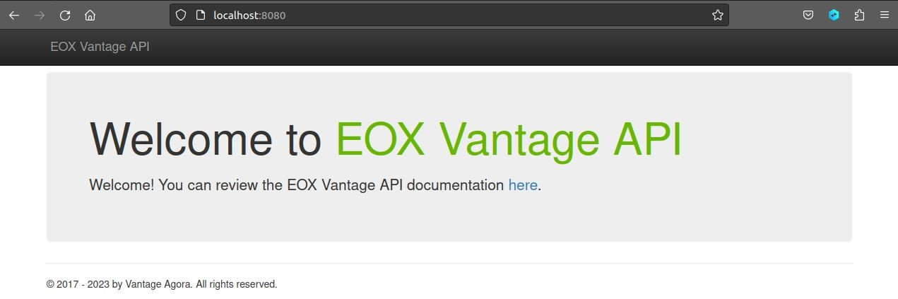
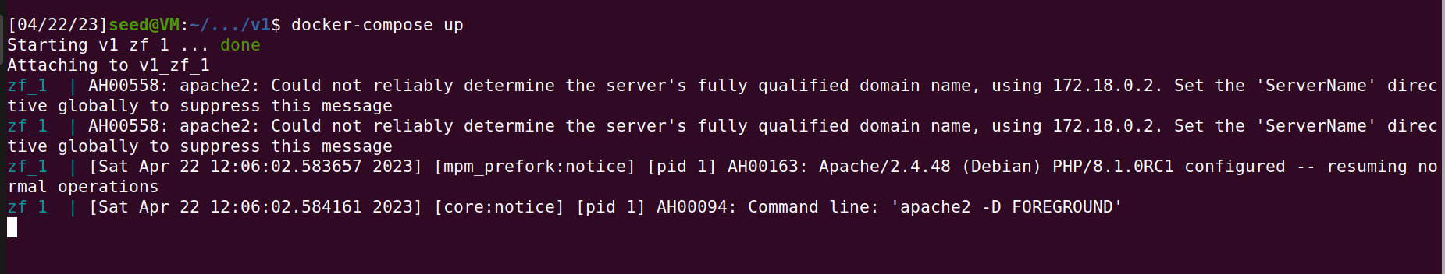
Deploy EOX microservices using cloud platform service and improving scalability.
Project Demo
The EOX vantage API build using Docker composer

Slide 30
Deploy EOX microservices using cloud platform service and improving scalability.
Project Progress
Install of Docker and setup.
Install MySql 5.7
Database Creation and configuration of rules.
Build API using docker-compose
Database Migration (ongoing currently)

Slide 31
Deploy EOX microservices using cloud platform service and improving scalability.
References
Deshpande, Neha (2021) Autoscaling Cloud-Native Applications using Custom Controller of Kubernetes.
https://norma.ncirl.ie/5089/
Masters thesis, Dublin, National College of Ireland.
Shitole, Abishek Sanjay (2022) Dynamic Load Balancing of Microservices in Kubernetes Clusters using Service Mesh.
https://norma.ncirl.ie/5943/
Masters thesis, Dublin, National College of Ireland.
An Efficient and Scalable Traffic Load Balancing Based on Web Server Container Resource Utilization using Kubernetes Cluster.(May – 2022) Ashok L Pomnar,
AVCOE Sangamner 422 605,Maharashtra, India.
https://ijisrt.com/assets/upload/files/IJISRT22MAY1644_(1)_(1).pdf
V. Sharma, "Managing Multi-Cloud Deployments on Kubernetes with Istio, Prometheus and Grafana," 2022 8th International Conference on Advanced Computing and Communication Systems (ICACCS), Coimbatore, India,
https://doi.org/10.1109/ICACCS54159.2022.9785124

Slide 32
Deploy EOX microservices using cloud platform service and improving scalability.
Thank You

